Slide 1

RING SIGNATURES

Slide 2
Monero Privacy Components
SENDER
AMOUNT
TRANSACTION
BROADCAST
RECEIVER
ɱ
RING
SIGNATURES
RING CONFIDENTIAL
TRANSACTIONS (RINGCT)
KOVRI
(I2P ROUTER)
STEALTH
ADDRESSES
Notes:
Monero is different from a mixing service. It uses three technologies and a work-in-progress fourth technology to provide trustless privacy for all transactions. These technologies work together to protect different parts of a transaction. The sender is hidden with ring signatures. The amount is hidden with ring confidential transactions, or RingCT. The transaction broadcast is not currently hidden without extra steps, but Monero is working on Kovri, an I2P router, to hide this with no additional effort. The receiver is hidden with stealth addresses. All of these technologies will be addressed in this presentation.

Slide 3
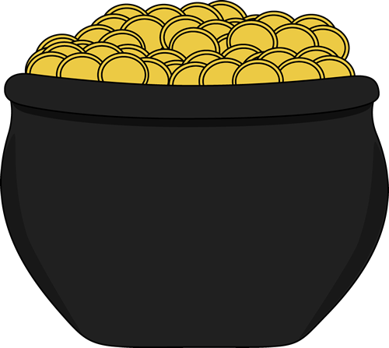

Ring Signatures and Plausible Deniability
Created Tx 1
Created Tx 12
Created Tx 7
Created Tx 18
Created Tx 10
Created Tx 9
Created Tx 20
key image
Notes:
The ring signature is just the process of taking your red (real) input, the blue ones (decoys), and making it seem as if they are all spent simultaneously. An outside observer does not know which is the real one, since they are all possible. In this example, the ringsize is 7, meaning that 7 total inputs (including your own) are used. As of August 2017, the minimum allowed by the network is 7. In September 2017, the minimum is expected to be increased to 5 or greater, since more decoys allows for better privacy. The key image is generated for the real input used. Nodes and miners can use this to verify that a real input is actually being spent, but they still do not know which input is real. The key image prevents attackers from spending money more than once or from spending money that does not exist.

Slide 4
History of Ringsizes in Monero
?
May
Min Ringsize 7
September
Min Ringsize 5
March
Min Ringsize 3
2014
2015
2016
2017
2018
2019

Slide 5
0-Decoy Attack and Chain Reaction
Created Tx 1
Created Tx 12
Created Tx 7
Created Tx 18
Created Tx 10
Created Tx 9
Created Tx 20
key image
Notes:
The ring signature is just the process of taking your red (real) input, the blue ones (decoys), and making it seem as if they are all spent simultaneously. An outside observer does not know which is the real one, since they are all possible. In this example, the ringsize is 7, meaning that 7 total inputs (including your own) are used. As of August 2017, the minimum allowed by the network is 7. In September 2017, the minimum is expected to be increased to 5 or greater, since more decoys allows for better privacy. The key image is generated for the real input used. Nodes and miners can use this to verify that a real input is actually being spent, but they still do not know which input is real. The key image prevents attackers from spending money more than once or from spending money that does not exist.

Slide 6
0-Decoy Attack and Chain Reaction
X
Created Tx 1
Created Tx 12
Created Tx 7
Created Tx 18
Created Tx 10
Created Tx 9
Created Tx 20
Created Tx 1
key image
Notes:
The ring signature is just the process of taking your red (real) input, the blue ones (decoys), and making it seem as if they are all spent simultaneously. An outside observer does not know which is the real one, since they are all possible. In this example, the ringsize is 7, meaning that 7 total inputs (including your own) are used. As of August 2017, the minimum allowed by the network is 7. In September 2017, the minimum is expected to be increased to 5 or greater, since more decoys allows for better privacy. The key image is generated for the real input used. Nodes and miners can use this to verify that a real input is actually being spent, but they still do not know which input is real. The key image prevents attackers from spending money more than once or from spending money that does not exist.

Slide 7
0-Decoy Attack and Chain Reaction
Created Tx 18
Created Tx 20
X
Created Tx 1
Created Tx 7
X
X
Created Tx 12
Created Tx 7
X
Created Tx 18
X
Created Tx 12
Created Tx 73
Created Tx 10
Created Tx 9
X
X
Created Tx 12
Created Tx 32
Created Tx 20
Created Tx 76
X
Created Tx 10
Created Tx 91
Created Tx 1
Created Tx 9
Created Tx 77
key image
Notes:
The ring signature is just the process of taking your red (real) input, the blue ones (decoys), and making it seem as if they are all spent simultaneously. An outside observer does not know which is the real one, since they are all possible. In this example, the ringsize is 7, meaning that 7 total inputs (including your own) are used. As of August 2017, the minimum allowed by the network is 7. In September 2017, the minimum is expected to be increased to 5 or greater, since more decoys allows for better privacy. The key image is generated for the real input used. Nodes and miners can use this to verify that a real input is actually being spent, but they still do not know which input is real. The key image prevents attackers from spending money more than once or from spending money that does not exist.

Slide 8
Chain Split and Key Image Reuse
CHAIN 1
CHAIN 2
X
X
Created Tx 1
SAME KEY IMAGE! ONLY ONE MATCH!
Created Tx 11
X
X
X
X
Created Tx 12
Created Tx 7
Created Tx 33
Created Tx 22
X
X
Created Tx 18
Created Tx 44
X
X
Created Tx 10
Created Tx 9
Created Tx 10
Created Tx 55
X
X
Created Tx 20
Created Tx 66
key image
key image
Notes:
The ring signature is just the process of taking your red (real) input, the blue ones (decoys), and making it seem as if they are all spent simultaneously. An outside observer does not know which is the real one, since they are all possible. In this example, the ringsize is 7, meaning that 7 total inputs (including your own) are used. As of August 2017, the minimum allowed by the network is 7. In September 2017, the minimum is expected to be increased to 5 or greater, since more decoys allows for better privacy. The key image is generated for the real input used. Nodes and miners can use this to verify that a real input is actually being spent, but they still do not know which input is real. The key image prevents attackers from spending money more than once or from spending money that does not exist.

Slide 9
Chain Split and Key Image Reuse
CHAIN 1
CHAIN 2
Created Tx 1
SAME KEY IMAGE! SEVERAL MATCHES
Created Tx 1
Created Tx 12
Created Tx 7
Created Tx 12
Created Tx 7
Created Tx 18
Created Tx 18
Created Tx 10
Created Tx 9
Created Tx 10
Created Tx 9
Created Tx 20
Created Tx 20
key image
key image
Notes:
The ring signature is just the process of taking your red (real) input, the blue ones (decoys), and making it seem as if they are all spent simultaneously. An outside observer does not know which is the real one, since they are all possible. In this example, the ringsize is 7, meaning that 7 total inputs (including your own) are used. As of August 2017, the minimum allowed by the network is 7. In September 2017, the minimum is expected to be increased to 5 or greater, since more decoys allows for better privacy. The key image is generated for the real input used. Nodes and miners can use this to verify that a real input is actually being spent, but they still do not know which input is real. The key image prevents attackers from spending money more than once or from spending money that does not exist.

Slide 10
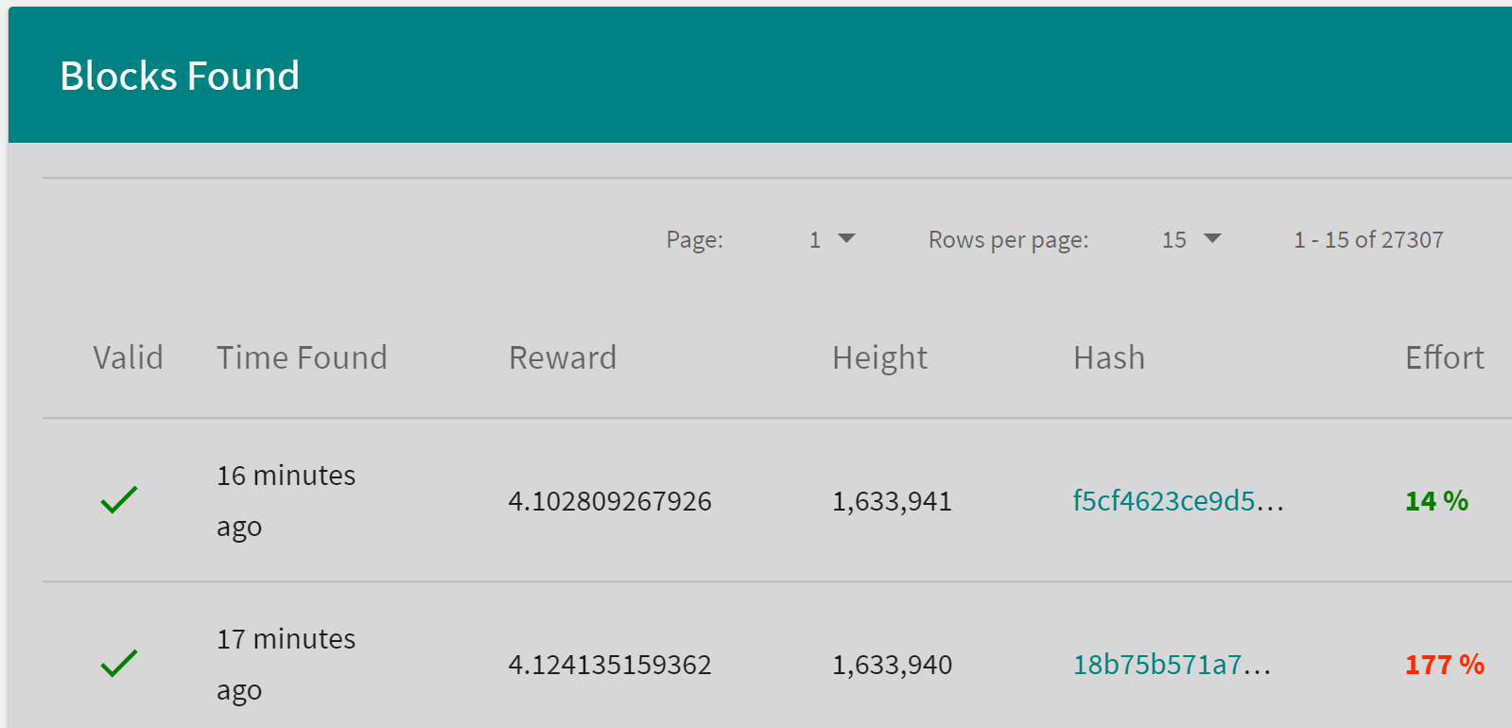
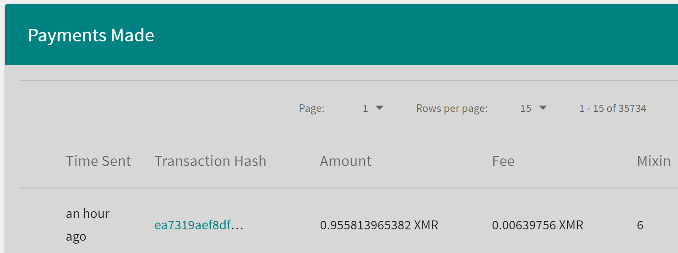
Mining Pool Public Data
Data: supportxmr.com
Created Tx 1
Created Tx 12
Created Tx 7
X
Created Tx 18
Created Tx 10
Created Tx 9
Created Tx 20
key image
Notes:
The ring signature is just the process of taking your red (real) input, the blue ones (decoys), and making it seem as if they are all spent simultaneously. An outside observer does not know which is the real one, since they are all possible. In this example, the ringsize is 7, meaning that 7 total inputs (including your own) are used. As of August 2017, the minimum allowed by the network is 7. In September 2017, the minimum is expected to be increased to 5 or greater, since more decoys allows for better privacy. The key image is generated for the real input used. Nodes and miners can use this to verify that a real input is actually being spent, but they still do not know which input is real. The key image prevents attackers from spending money more than once or from spending money that does not exist.

Slide 11
Mining Pool Public Data
Data: supportxmr.com
Secret churning
Blackball coinbase outputs
Modified input selection algorithm

Slide 12
Mining Pool Public Data
Tx 98
Tx 99
X
Created Tx 1
Created Tx 98
Created Tx 1
X
X
Created Tx 12
Created Tx 7
Created Tx 12
Created Tx 7
X
Created Tx 18
Created Tx 98
Created Tx 18
Created Tx 10
Created Tx 9
Created Tx 98
Created Tx 98
Created Tx 20
Created Tx 98
Created Tx 98
key image
key image
Assumes the initial output is secretly churned
Pool transaction
Notes:
The ring signature is just the process of taking your red (real) input, the blue ones (decoys), and making it seem as if they are all spent simultaneously. An outside observer does not know which is the real one, since they are all possible. In this example, the ringsize is 7, meaning that 7 total inputs (including your own) are used. As of August 2017, the minimum allowed by the network is 7. In September 2017, the minimum is expected to be increased to 5 or greater, since more decoys allows for better privacy. The key image is generated for the real input used. Nodes and miners can use this to verify that a real input is actually being spent, but they still do not know which input is real. The key image prevents attackers from spending money more than once or from spending money that does not exist.

Slide 13
Mining Pool Public Data
Tx 98
Tx 100
Created Tx 1
Created Tx 98
Created Tx 1
Created Tx 12
Created Tx 7
Created Tx 12
Created Tx 7
Created Tx 18
Created Tx 98
Created Tx 18
Created Tx 10
Created Tx 9
Created Tx 98
Created Tx 9
Created Tx 20
Created Tx 98
Created Tx 20
key image
key image
Assumes the initial output is secretly churned
Standard transaction
Notes:
The ring signature is just the process of taking your red (real) input, the blue ones (decoys), and making it seem as if they are all spent simultaneously. An outside observer does not know which is the real one, since they are all possible. In this example, the ringsize is 7, meaning that 7 total inputs (including your own) are used. As of August 2017, the minimum allowed by the network is 7. In September 2017, the minimum is expected to be increased to 5 or greater, since more decoys allows for better privacy. The key image is generated for the real input used. Nodes and miners can use this to verify that a real input is actually being spent, but they still do not know which input is real. The key image prevents attackers from spending money more than once or from spending money that does not exist.

Slide 14
High Output Control (Exchanges & Wallets)
ATTACKER WALLET
X
Created Tx 1
Created Tx 1
Created Tx 2
Created Tx 3
Created Tx 4
Created Tx 5
X
X
Created Tx 12
Created Tx 7
X
Created Tx 18
Created Tx 6
Created Tx 7
Created Tx 8
Created Tx 9
Created Tx 11
X
Created Tx 10
Created Tx 9
X
Created Tx 20
Created Tx 12
Created Tx 13
Created Tx 14
Created Tx 15
Created Tx 16
Created Tx 17
Created Tx 18
Created Tx 19
Created Tx 20
Created Tx 21
key image
Notes:
The ring signature is just the process of taking your red (real) input, the blue ones (decoys), and making it seem as if they are all spent simultaneously. An outside observer does not know which is the real one, since they are all possible. In this example, the ringsize is 7, meaning that 7 total inputs (including your own) are used. As of August 2017, the minimum allowed by the network is 7. In September 2017, the minimum is expected to be increased to 5 or greater, since more decoys allows for better privacy. The key image is generated for the real input used. Nodes and miners can use this to verify that a real input is actually being spent, but they still do not know which input is real. The key image prevents attackers from spending money more than once or from spending money that does not exist.

Slide 15
What Can You Do?

Slide 16
Blackball Known Compromised Outputs
Exclude them from your ring signature
Items to exclude:
0-decoy transaction inputs (low priority)
Unique inputs used on several chains with identical key images
Public pool data
Outputs known to be controlled by large wallets and exchange (difficult to obtain)

Slide 17
Churn
7² = 49
7³ = 343
7⁴ = 2,401
7⁵ = 16,807
7⁷ = 823,543
7⁶ = 117,649
7⁸ = 5,764,801
7⁹ = 40,353,607
ANONYMITY SET

Slide 18
Spend During Good Times
Avoid spending shortly before or after times when the network has a high proportion of poisoned outputs
Impossible to avoid all of these since not all information is public, but can work around announced chain splits, etc. if possible
Avoid spending if the Monero network is being spammed with transactions

Slide 19
Different Types of Linkability

Slide 20

Linking Subaddresses and Transactions
<SUBADDRESS 1>
<SUBADDRESS 2>
Created Tx 1
Created Tx 11
Created Tx 12
Created Tx 7
Created Tx 22
Created Tx 33
Created Tx 18
Created Tx 44
Created Tx 10
Created Tx 9
Created Tx 99
Created Tx 55
Created Tx 20
Created Tx 66
key image
key image
Notes:
Monero introduced a subaddress feature where one wallet can have several addresses without these addresses being linked to each other
Practically, these subaddresses can still be linked if outputs are spent together
If concerned, churn each output individually or use entirely different wallets for each transaction and churn

Slide 21
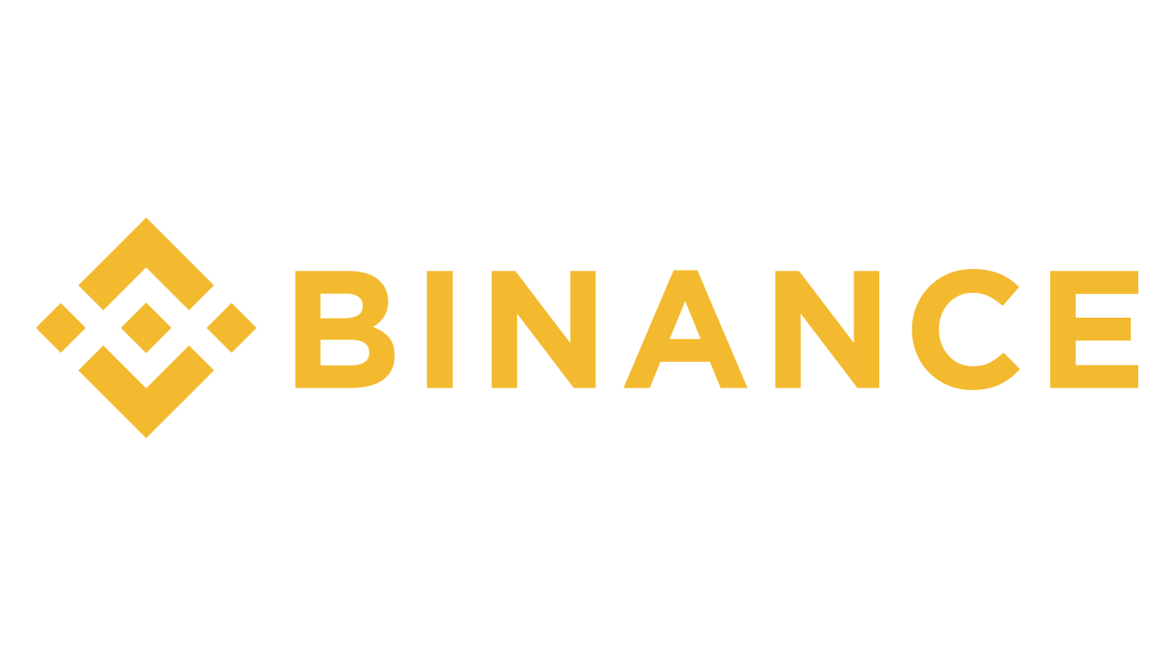
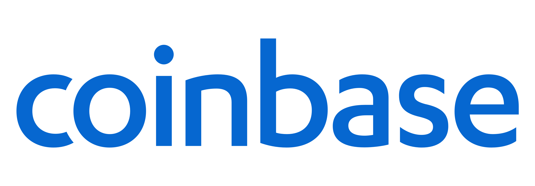
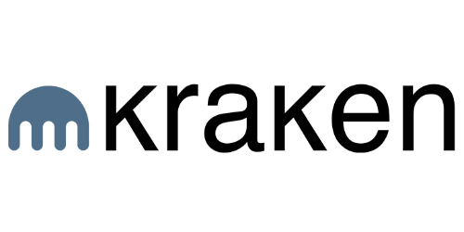

Linking (Sub)Addresses to Real-World Identity
Adding additional entropy before and after sending funds to someone who knows your identity, including friends, family, merchants, and KYC/AML exchanges
Churn before making these transactions
Notes:
The ring signature is just the process of taking your red (real) input, the blue ones (decoys), and making it seem as if they are all spent simultaneously. An outside observer does not know which is the real one, since they are all possible. In this example, the ringsize is 7, meaning that 7 total inputs (including your own) are used. As of August 2017, the minimum allowed by the network is 7. In September 2017, the minimum is expected to be increased to 5 or greater, since more decoys allows for better privacy. The key image is generated for the real input used. Nodes and miners can use this to verify that a real input is actually being spent, but they still do not know which input is real. The key image prevents attackers from spending money more than once or from spending money that does not exist.

Slide 22
Linking Outputs
You want every output you touch to have no association with any other outputs you have
Ideally a trait in a completely fungible system, but Monero is not completely fungible against all heuristics, only plausible deniability
Always churn every output separately, and churn every time you receive funds, including non-churn change from your transactions
Notes:
The ring signature is just the process of taking your red (real) input, the blue ones (decoys), and making it seem as if they are all spent simultaneously. An outside observer does not know which is the real one, since they are all possible. In this example, the ringsize is 7, meaning that 7 total inputs (including your own) are used. As of August 2017, the minimum allowed by the network is 7. In September 2017, the minimum is expected to be increased to 5 or greater, since more decoys allows for better privacy. The key image is generated for the real input used. Nodes and miners can use this to verify that a real input is actually being spent, but they still do not know which input is real. The key image prevents attackers from spending money more than once or from spending money that does not exist.

Slide 23
Challenges for Increasing the Ringsize

Slide 24
Ringsize Challenges
Notes:
Transaction size and the effect on bandwidth and fees
Verification time and the effect on fees
Relating to specific threat models and impact
Unusual ringsize leads to leaked metadata

Slide 25
Summary
Covered 4 different ways for ring signatures to lose plausible deniability
Covered several considerations for heuristic tests
Covered best-practices for using Monero’s ring signatures correctly in a variety of use-cases
Covered the challenges of increasing Monero’s ringsize

Slide 26


Thank You!
getmonero.org
/r/Monero
monero.stackexchange.com
justin@ehrenhofer.org

